Slide 1
AI System Fundamentals & Heterogeneous Computing
Hardware and Software Fundamentals of Intelligent Computing Systems
Guojie Luo
2026/8/4

Slide 2
Outline
AI Computing and Heterogeneous Hardware
Heterogeneous Programming Fundamentals
Triton Programming Basics
Lab: AI Operators and GEMM Tuning

Slide 3


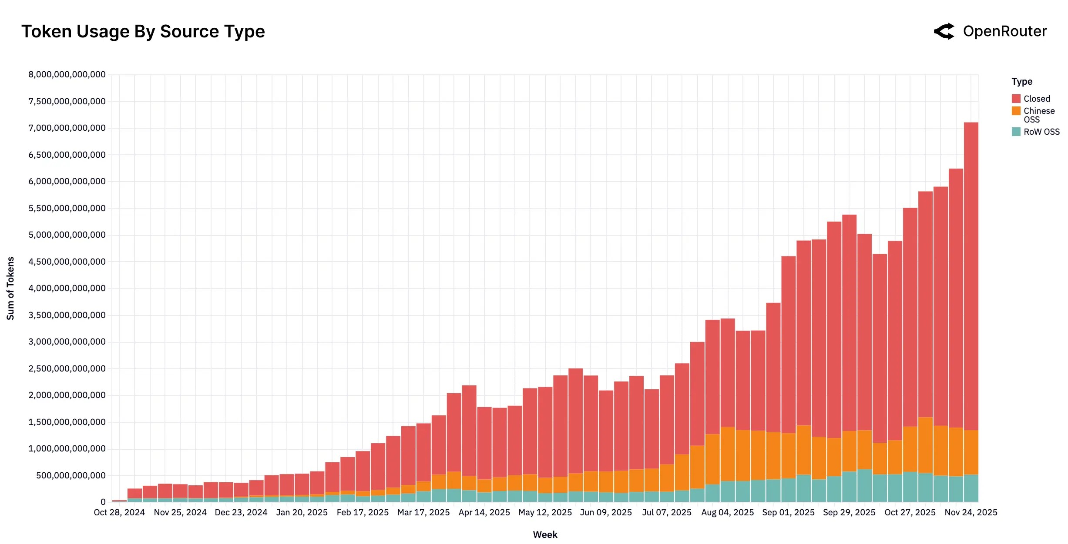

Token-Hungry Generative AI Applications
LLM-powered autonomous agents
Token consumption trends
AI mobile phone and AI PC
Video generation

Slide 4
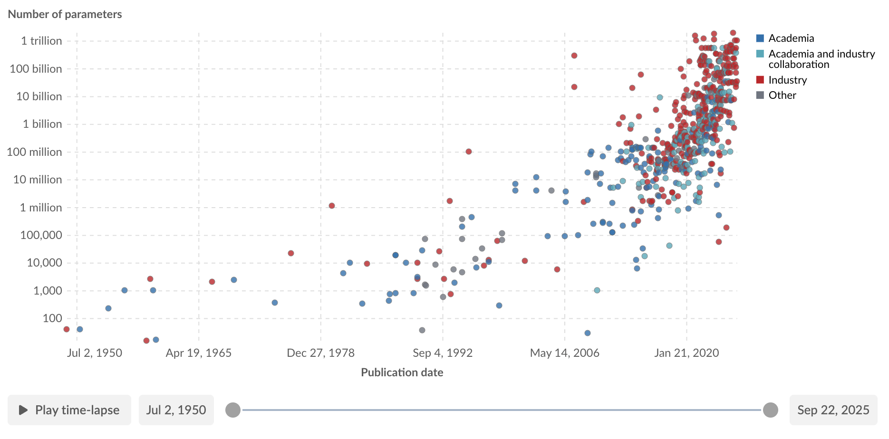
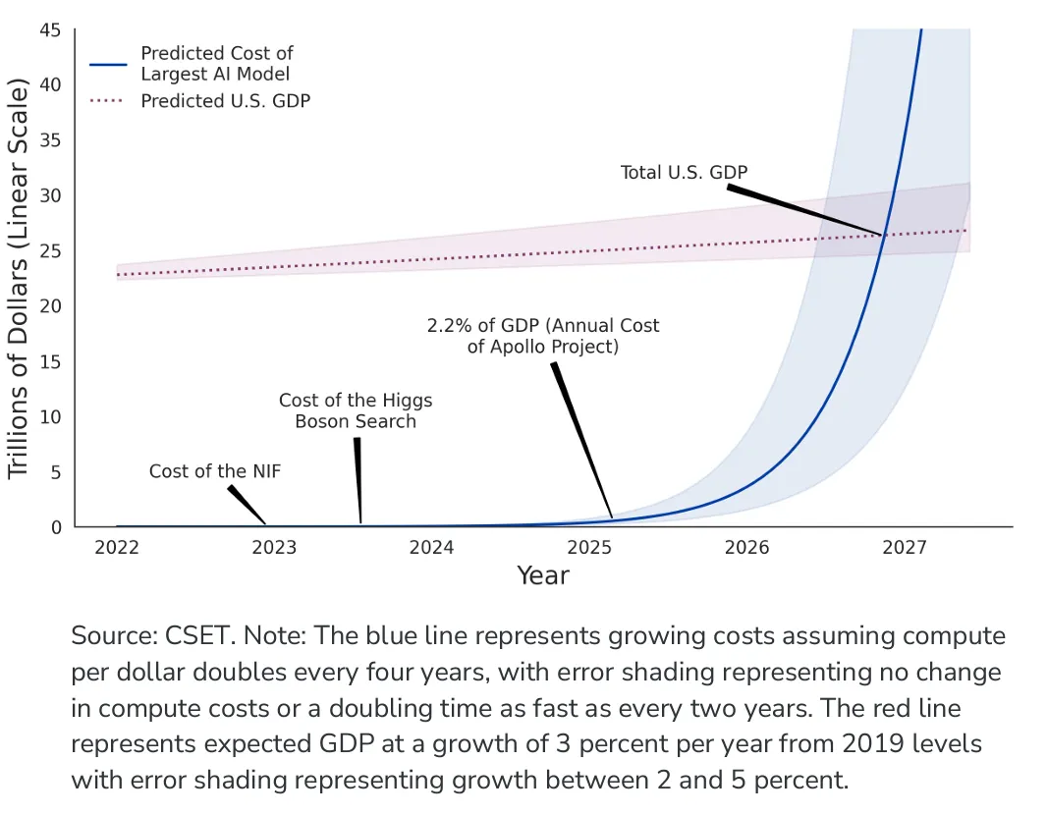
The Hardware Demands of AI/ML
Model Parameters
  The exponential growth.
Computational Demand
  Outpacing the Moore's Law.
  Comparison between compute cost and U.S GDP byOpenAI.
Communication Scale
  The new critical bottleneck.

Slide 5
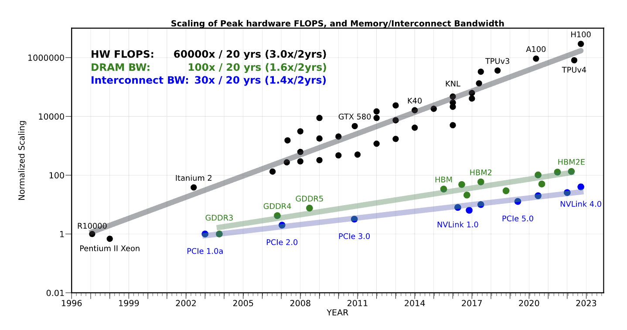
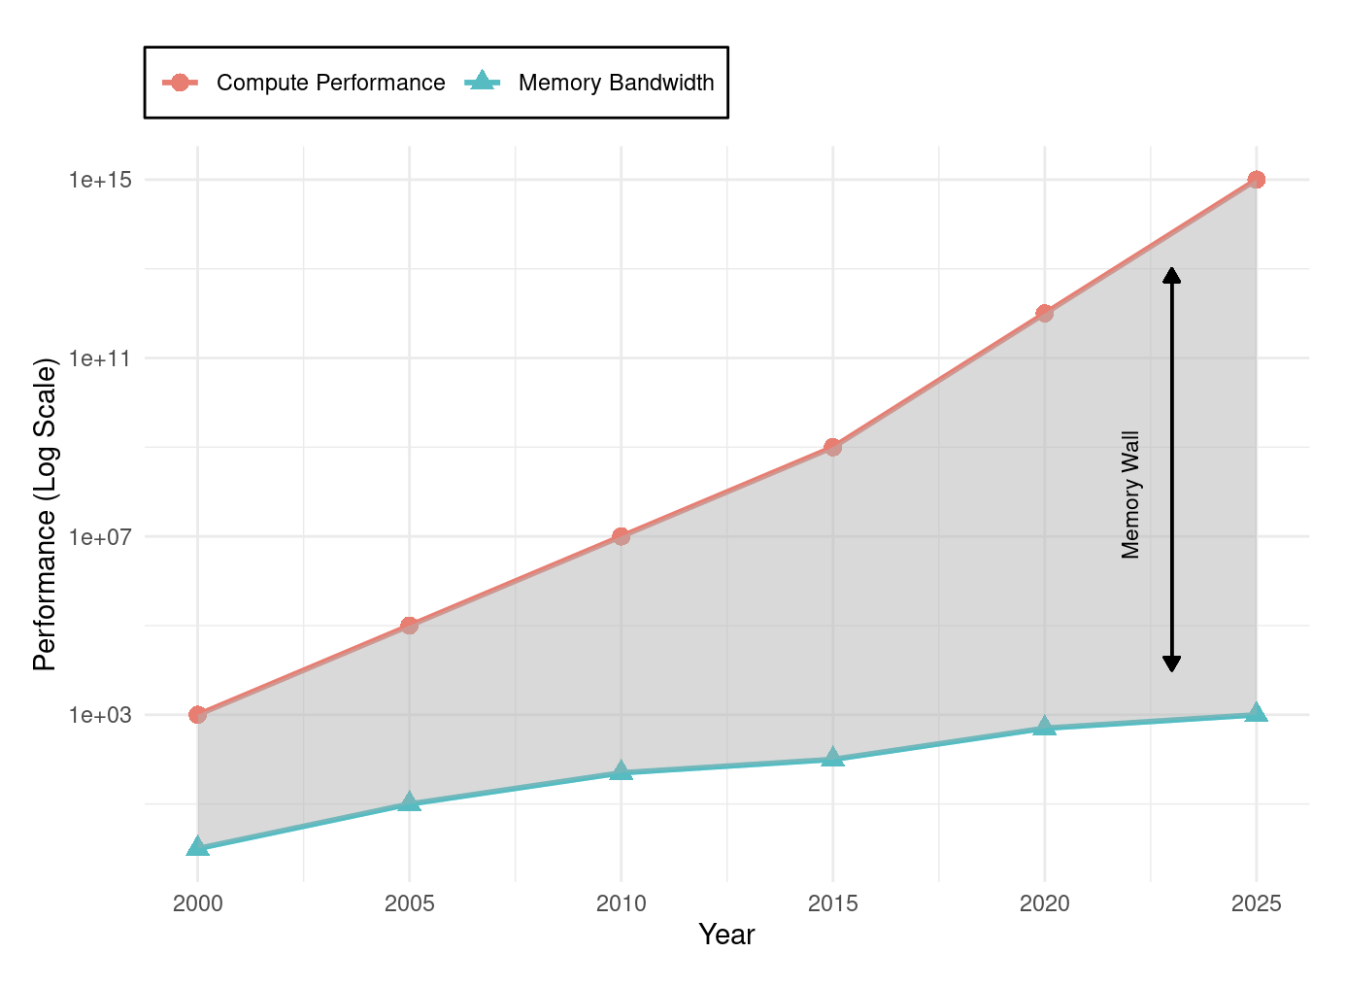
Why General-Purpose CPUs Failed AI
The CPU's Legacy:
  For decades, the Central Processing Unit (CPU) was the universal engine of computing, designed for sequential, general-purpose tasks.
The Two Crises:
  Von Neumann Bottleneck
  End of Performance Scaling

Slide 6
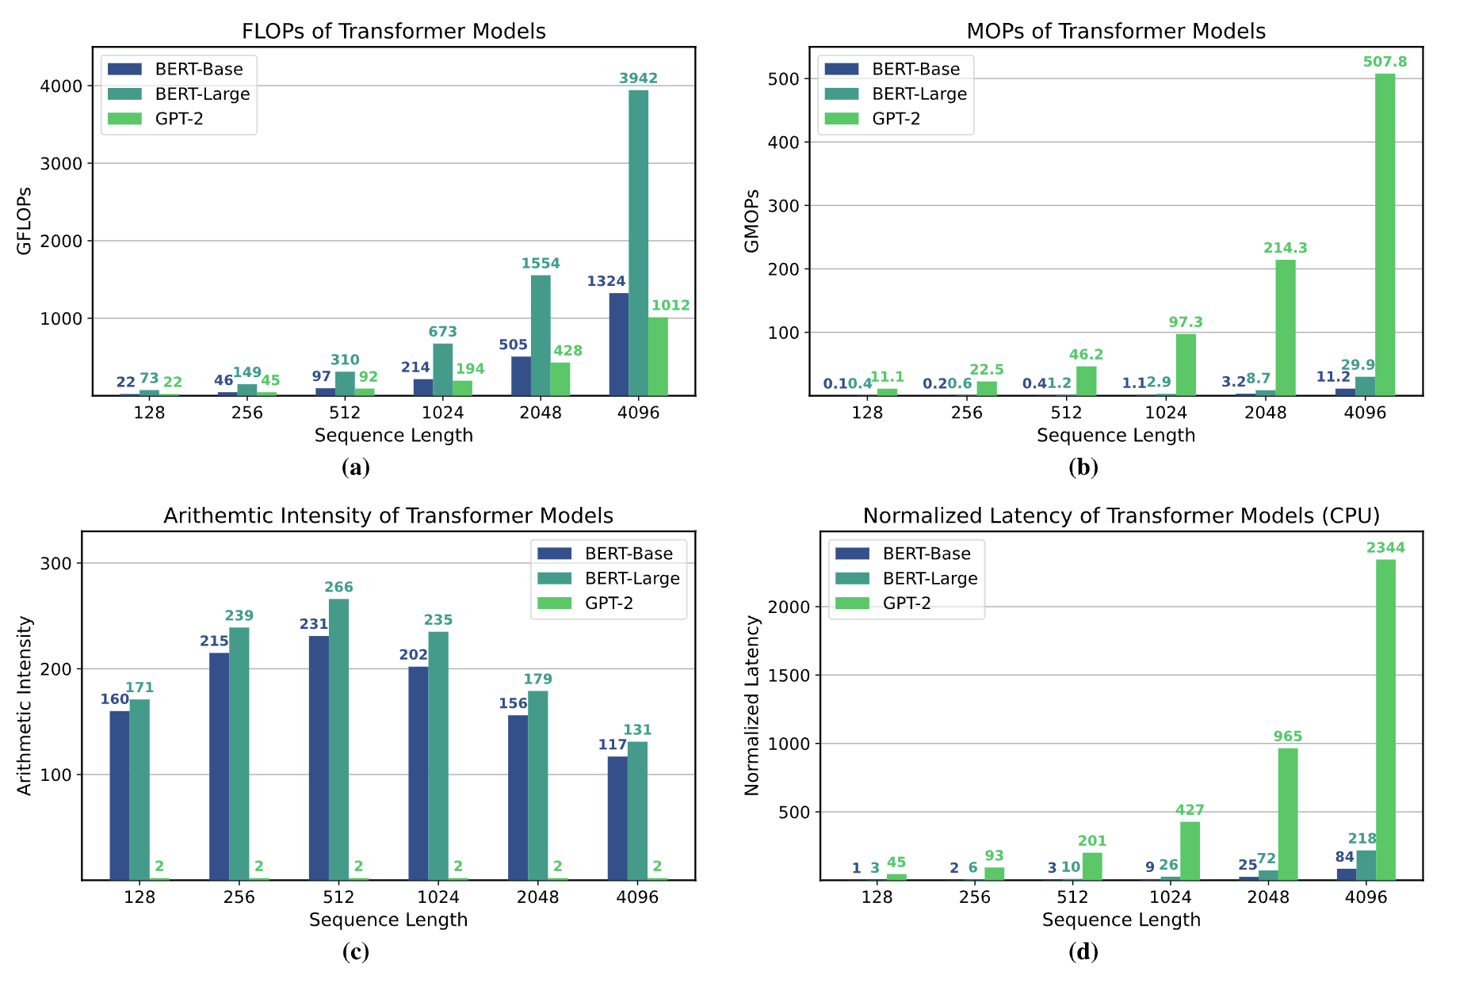
Why General-Purpose CPUs Failed AI
The Mismatch:
  CPUs' sequential design is fundamentally inefficient for the massive parallelism inherent in AI workloads like matrix multiplication.
  CPUs achieve only 5-10% utilization on neural network workloads, delivering approximately 100 GFLOPS10 while consuming hundreds of watts*.
Conclusion:
  AI's exponential demands exposed the limits of the general-purpose model, forcing a shift to specialized hardware.

Slide 7
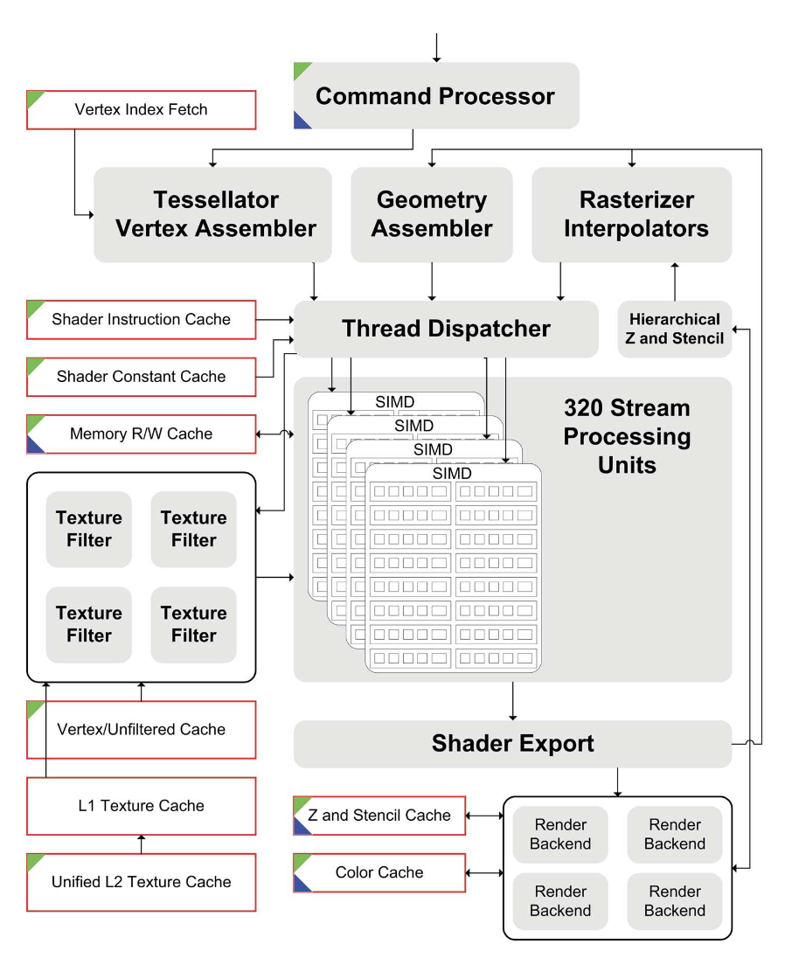
The Rise of the GPU
An Unlikely Hero: The Graphics Processing Unit (GPU) was born in the late 1990s for video game graphics, featuring thousands of simple cores for parallel tasks.
Architectural Resonance: The core math of graphics (matrix and vector operations) was identical to the math of deep learning, making GPUs a perfect, albeit accidental, fit.

Slide 8
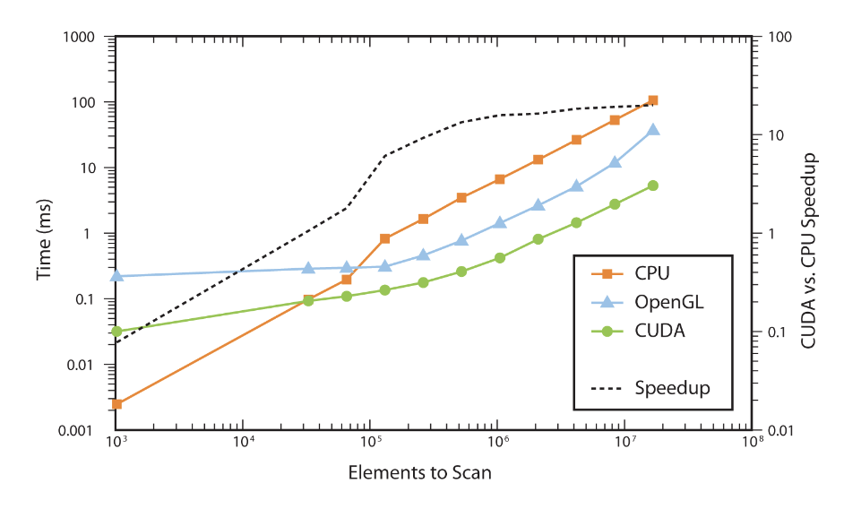
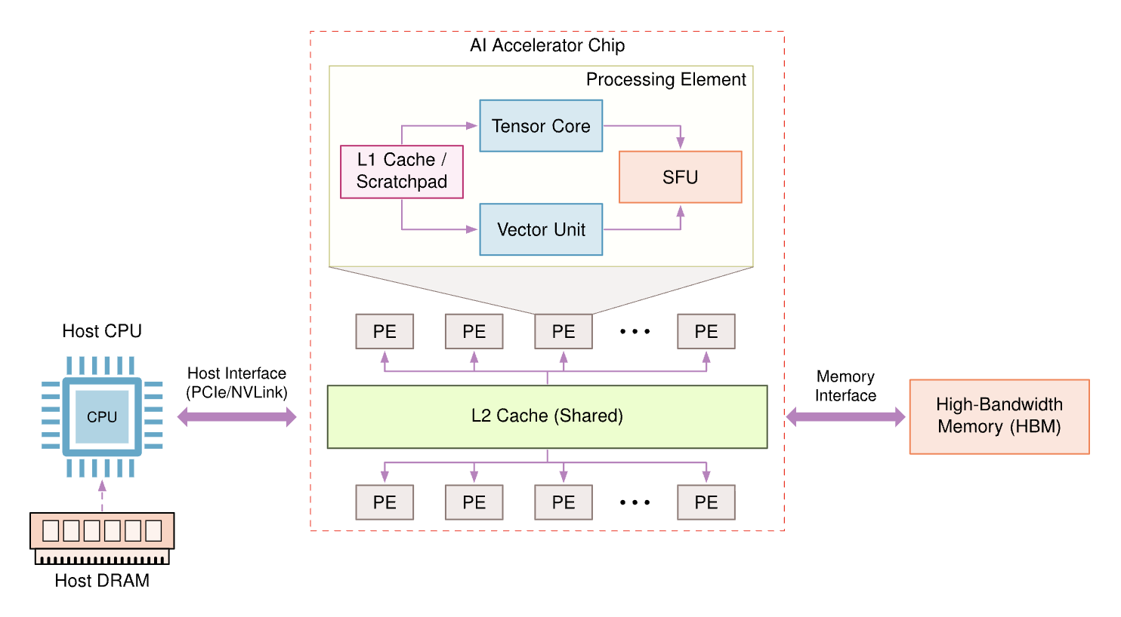
The Rise of the GPU
The Software Catalyst: CUDA: NVIDIA's CUDA platform (2007) unlocked the GPU for general-purpose computing, making its power accessible to AI researchers without deep graphics expertise.
The Result: Training times for AI models plummeted from weeks to hours, establishing the GPU as the de facto standard for AI training.

Slide 9
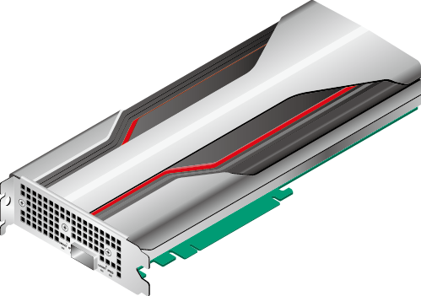
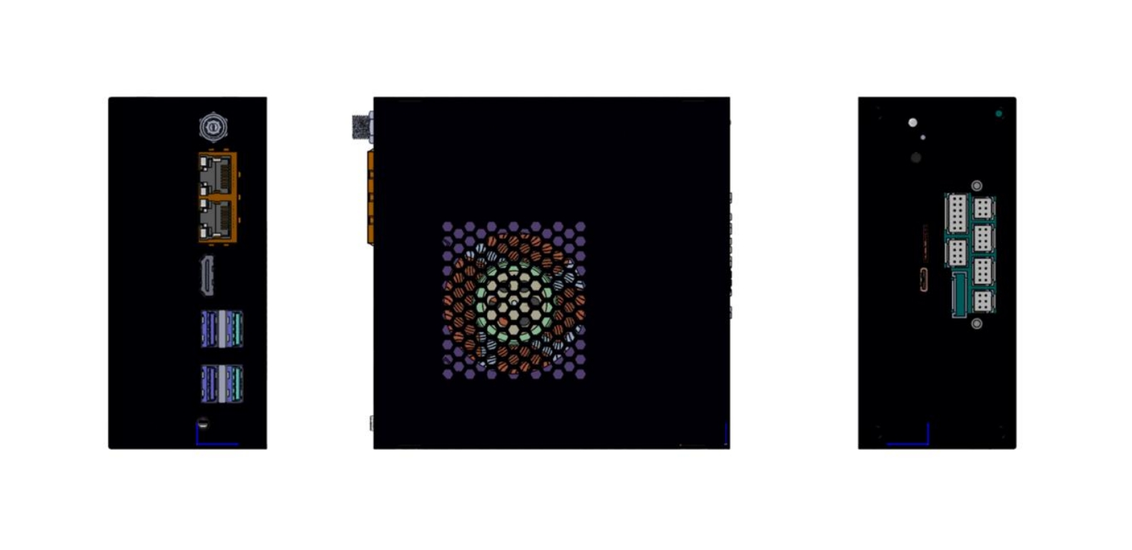
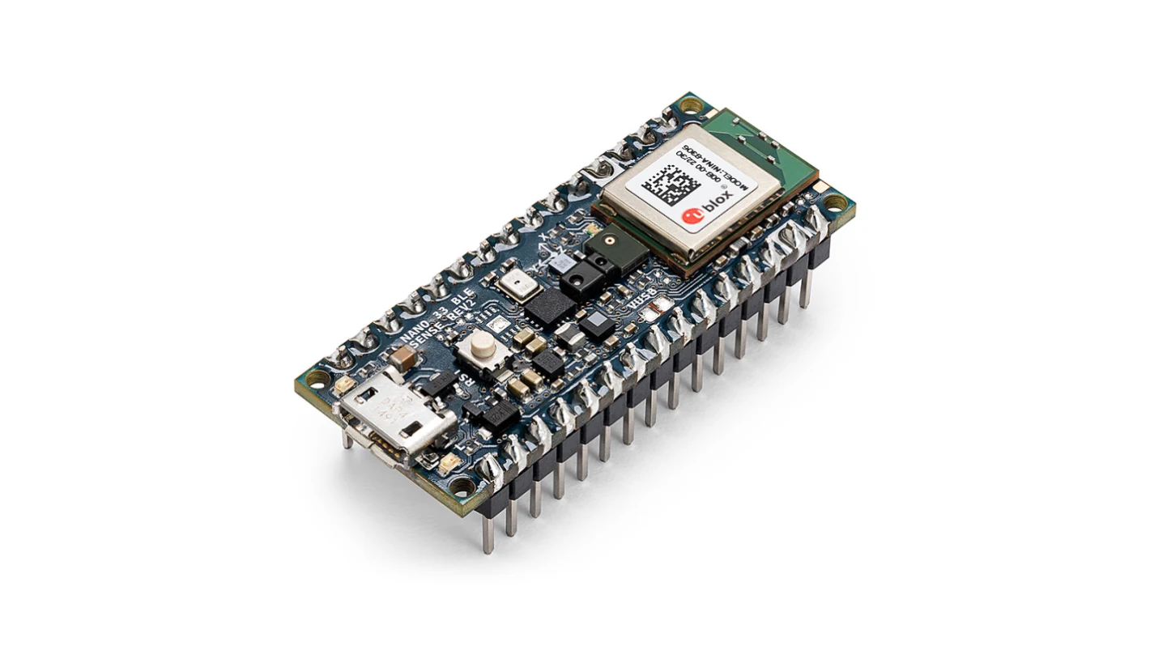

AI Hardware Spectrum: Key Examples
Cloud ML
Huawei Ascend
Cambricon MLU370
etc.
Edge ML
Iluvatar
TY1200
Mobile ML
Kirin 9030 Pro
Tiny ML
Arduino Nano 33
BLE Sense

Slide 10
Compute Architectures Evolve
GPU series (+ Tensor cores)
TPU series
Ascend series
CPU series: Intel (+ matrix extension); AMD (+ NPU)
compute-in-memory
wafer-scale chip
Supernode and Hypercomputer
...

Slide 11
Different Processors Optimize Different Trade-offs
CPU | GPU | NPU
Optimized for low latency and complex control | Optimized for highly parallel throughput | Optimized for common AI dataflows
A small number of powerful cores | Many parallel execution lanes | Matrix and vector engines with on-chip buffers
Large caches and branch prediction | SIMT execution and high-bandwidth memory | High efficiency for supported operators and data types
Best suited for orchestration, preprocessing and control-heavy workloads | Best suited for tensor operations and programmable kernels | Usually driven by compiler, graph and framework toolchains
Modern AI systems combine CPUs and accelerators rather than relying on a single processor type.

Slide 12
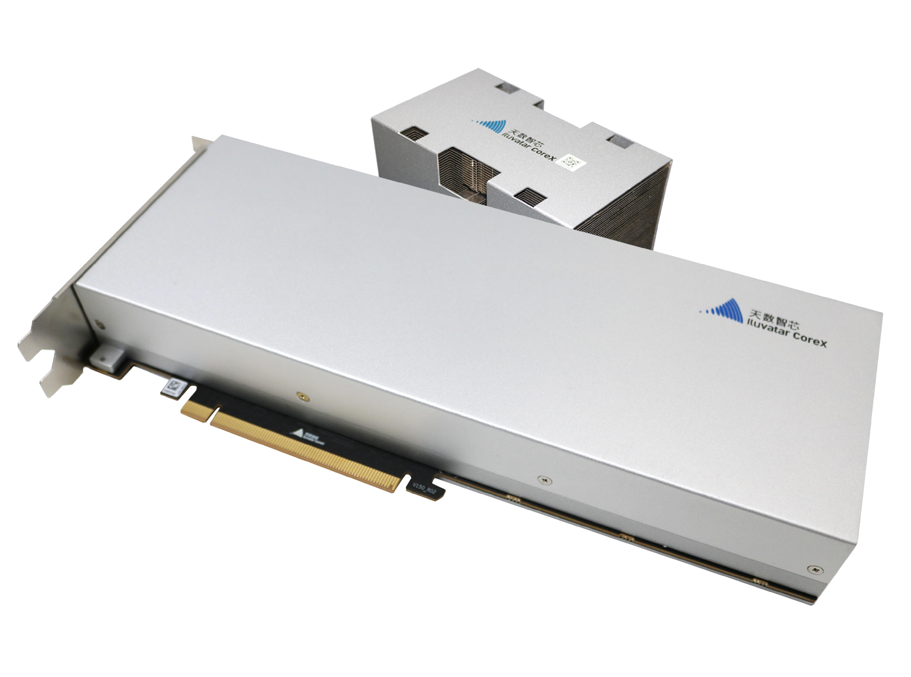
Iluvatar BI-V150: A General-Purpose GPU for AI Computing
1.Product Positioning
General-Purpose GPU
  Developed by Iluvatar CoreX for AI training, inference and general-purpose computing
  Available as an air-cooled PCIe accelerator card
  Designed for deployment in multi-card and multi-node computing systems

Slide 13
Iluvatar BI-V150: A General-Purpose GPU for AI Computing
2.Hardware Architecture
Specification | BI-V150
GPU architecture | ivcore11
Process technology | 7 nm
Device memory | 64 GB HBM2e
Host interface | PCIe 4.0 ×16
Peak board power | 350 W

Slide 14
Iluvatar BI-V150: A General-Purpose GPU for AI Computing
3. Execution and Programming Model
CUDA-Compatible, but Architecturally Different
  PyTorch / Triton
  ↓
  CoreX-adapted framework and compiler packages
  ↓
  IXUCA runtime and vendor libraries
  ↓
  Driver
  ↓
  BI-V150
Grid -> Thread Block -> Warp (64 threads) -> Thread

Slide 15
Outline
AI Computing and Heterogeneous Hardware
Heterogeneous Programming Fundamentals
Triton Programming Basics
Lab: AI Operators and GEMM Tuning

Slide 16
Questions on Heterogeneous Programming
How to compile the “kernel” code?
How do CPU and GPU interact?
How to express parallelism?
How to express synchronization?
How to manage and access data?
How is kernel code executed on GPU?

Slide 17
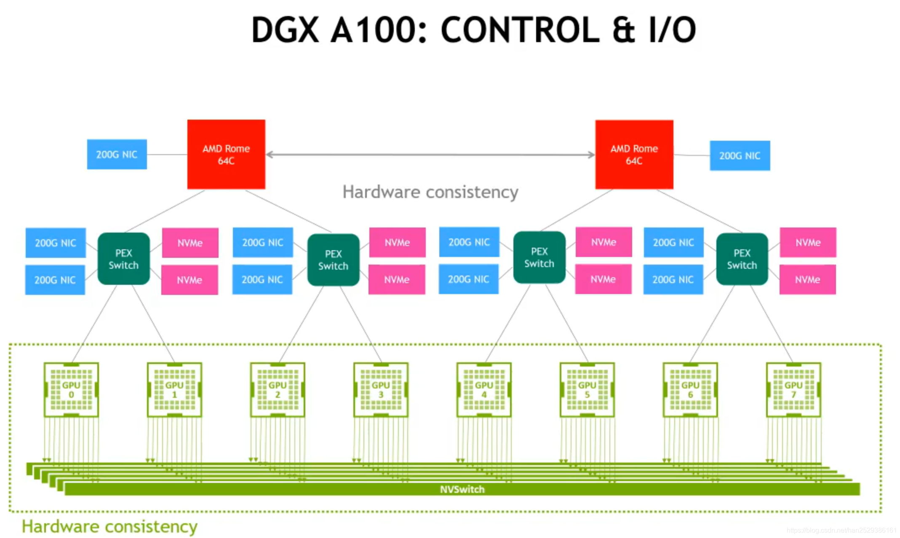
Hetergeneous Integration of CPU and XPUs
Inter-chip (board-level) integration
  protocols: PCIe, NVLink, etc.
Intra-chip integration
  protocols: one-way or two-way coherency
CPU
“host”
XPU
“device”
CPU
“host”
XPU
“device”

Slide 18
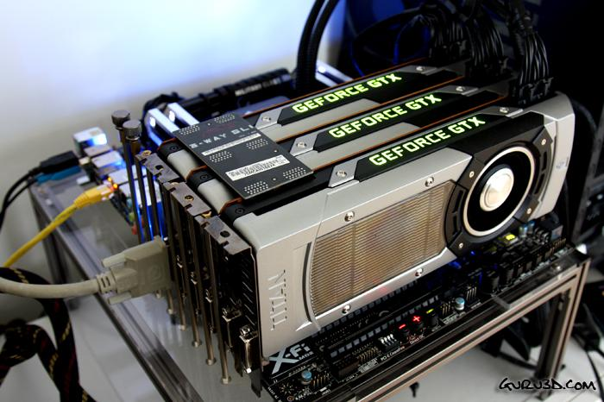
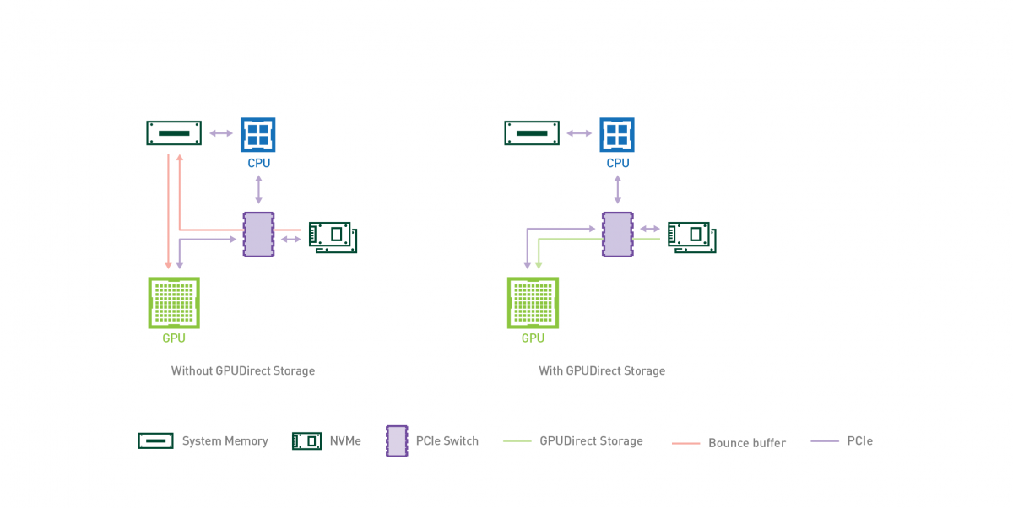
PCIe Role in AI: GPU-Host Connection
GPU connect to most Host with PCIe
  Host->GPU: Commands (CUDA kernels, OpenCL bin)
    Training data, Model weights...
  GPU->Host: GPU status (kernel completion, CUDA events)
    Computation results (gradients, inference output)...
Traditional Data Transfer
  1st Copy: NVMe SSD -> host Memory [with DMA]
  2nd Copy: host Memory -> GPU Memory
Nvidia GPUDirect Storage (from 2020.06)
  Only 1 Copy: NVMe SSD -> GPU Memory
GPUs to mainboard with PCIe

Slide 19
Hosts Submit Work; Streams Order Kernels
KERNEL → KERNEL
  Kernel A writes an intermediate tensor
  Same stream: ordered dependency
  Kernel B reads the tensor
Events express dependencies across streams.
HOST -> KERNEL
  Allocate device tensors
  Enqueue copies and kernel launches
  Continue without waiting for completion
  Synchronize before reading results
A launch is usually asynchronous.
CUDA
Streams · Events · Device / Unified Memory
CANN
Device · Context · Stream · aclrtMemcpyAsync

Slide 20
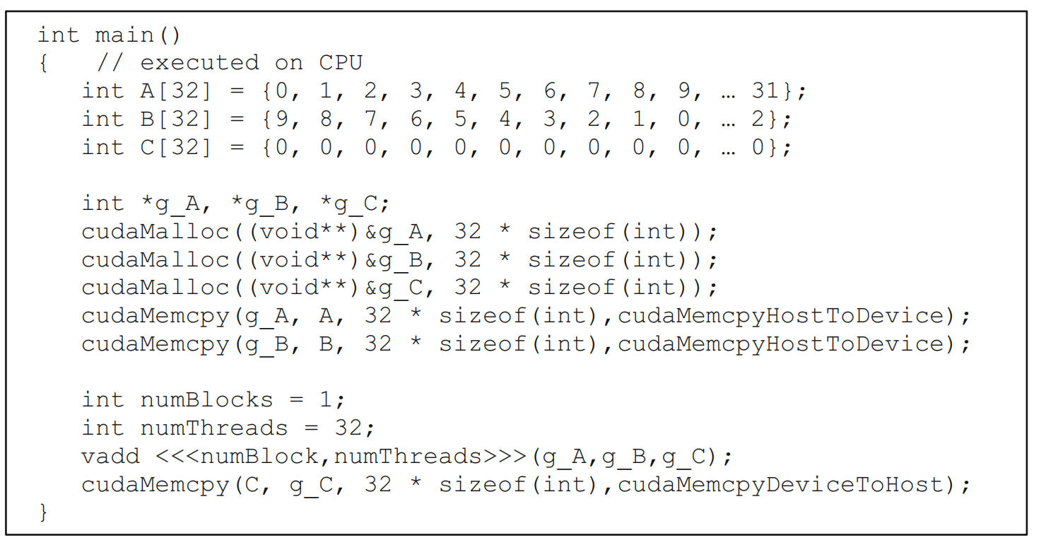
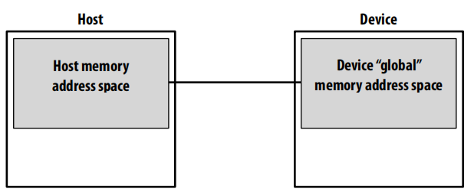
How to Manage and Access Data?
CUDA memory model
  Distinct host and device address spaces (when not using unified memory)
  Memory allocation in GPU through cudaMalloc()
  Move data between address spaces through cudaMemcpy()

Slide 21
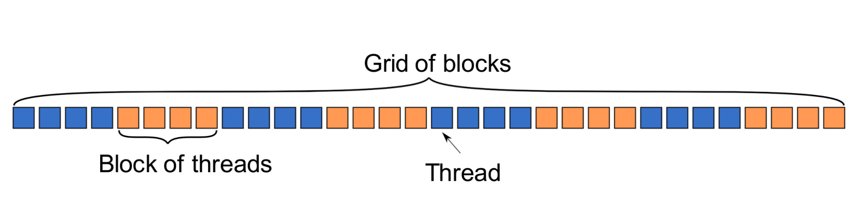
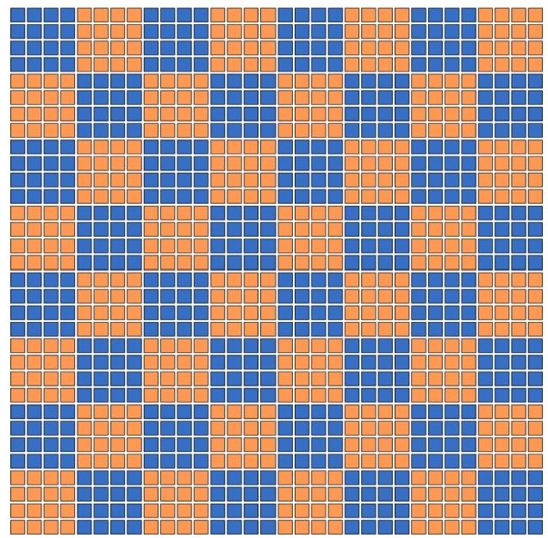
How to Express Parallelism?
1D Grid
Threads in grid have access to:
  Their respective block: blockIdx.x
  Their respective thread ID in a block: threadIdx.x
  Their block's dimension: blockDim.x
  The number of blocks in the grid: gridDim.x
2D Grid
Threads in grid have access to:
  Their respective block IDs: blockIdx.x, blockIdx.y
  Their respective thread IDs in a block: threadIdx.x, threadIdx.y

Slide 22
How to Express the Work of a Thread
A device function that will be launched from the host program is called a kernel & is declared with the __global__ attribute
Kernels should be declared void
All pointers passed to kernels must point to memory on the device
Threads are grouped into warps and scheduled concurrently when resources permit.
Each thread uses its unique thread and block IDs to compute a global ID
There could be more than N threads in the grid
Kernels are launched from the host:
A simple embarrassingly parallel loop:
for (int i= 0; i<N; i++)
h_a[i] *= 2.0;
Can be translated into a GPU kernel:
__global__ void myKernel(int N, double *d_a) {
int i = threadIdx.x + blockIdx.x * blockDim.x;
if (i<N) d_a[i] *= 2.0;
}

Slide 23
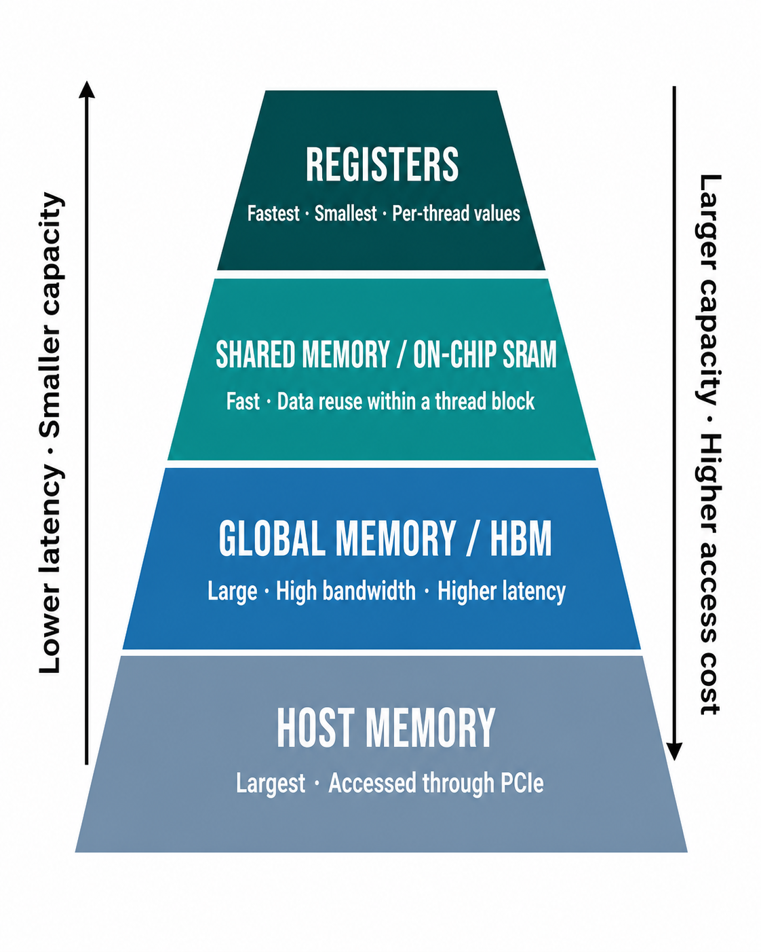
GPU Memory Hierarchy: Capacity, Latency, and Data Reuse
Why Does the Hierarchy Matter?
  Global memory provides capacity, but unnecessary traffic is expensive.
  Registers hold thread-local intermediate values.
  Shared memory enables threads in a block to reuse data.
  Coalesced accesses improve effective global-memory bandwidth.
  Tiling loads data once and reuses it for multiple computations.

Slide 24
Three Ways to Express a Kernel
CUDA SIMT | CUDA Tile | Ascend C
Unit: individual thread | Unit: compile-time tile | Unit: operator tile
Grid, block, threadIdx | Grid of tile blocks; compiler maps threads | Host tiling + AI Core blocks
Explicit indexing, shared memory and synchronization | Load, compute and store whole tiles | CopyIn → Compute → CopyOut
NVIDIA CUDA target | cuTile Python / CUDA Tile C++ | Ascend AI Core / CANN
Triton is also tile-oriented, but it uses its own DSL, compiler, and target backend.
Notes:
[Sources]
- https://docs.nvidia.com/cuda/cuda-programming-guide/02-basics/writing-cuda-kernels.html
- https://docs.nvidia.com/cuda/cuda-programming-guide/02-basics/writing-tile-kernels.html
- https://www.hiascend.com/document/detail/zh/CANNCommunityEdition/latest/programug/Ascendcopdevg/docs/guide/%E5%85%A5%E9%97%A8%E6%95%99%E7%A8%8B/Ascend-C%E6%A6%82%E8%BF%B0%E4%B8%8E%E5%AD%A6%E4%B9%A0%E8%B7%AF%E5%BE%84.md
- https://www.hiascend.com/document/detail/zh/CANNCommunityEdition/850/API/ascendcopapi/atlasascendc_api_07_0003.html
[/Sources]

Slide 25
Outline
AI Computing and Heterogeneous Hardware
Heterogeneous Programming Fundamentals
Triton Programming Basics
Lab: AI Operators and GEMM Tuning

Slide 26
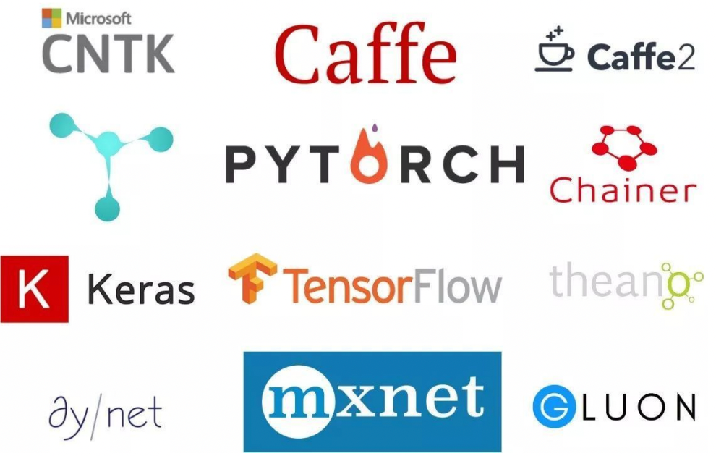
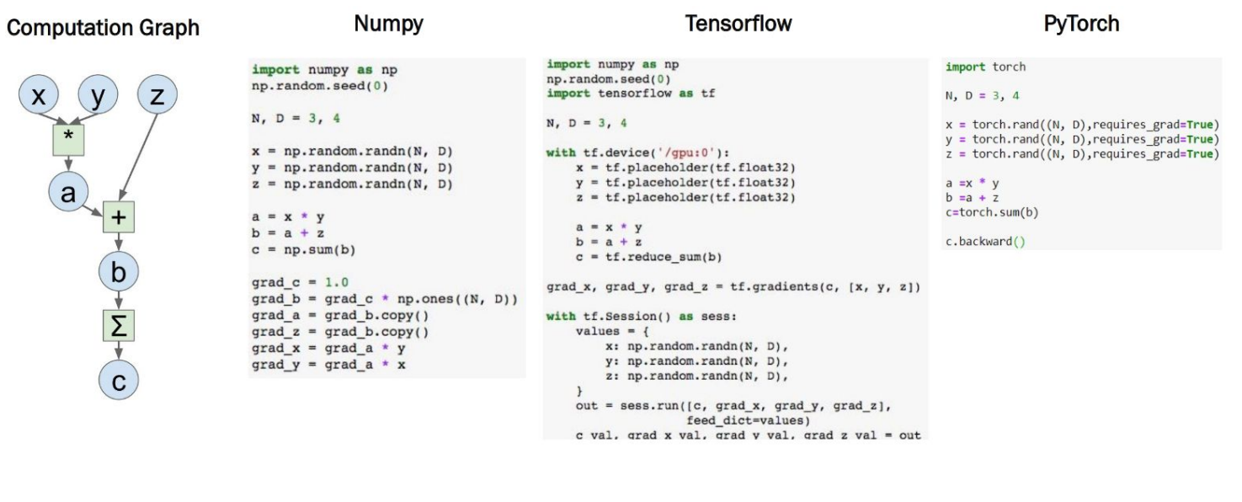
PyTorch Provides the High-Level Operator Interface
PyTorch: The (most) popular open-source ML library.
  Tensor definition; GPU-enabled computation; Automatic Differentiation; Compiler Support.
Other ML Frameworks
Numpy vs TensorFlow vs PyTorch

Slide 27
Why Triton?
High-Performance GPU Kernels with Pythonic Ease
Productivity-Performance Dilemma
  Frameworks like PyTorch
    High productivity, but "fusing" custom operators often requires using CUDA C++ to avoid overhead
  CUDA C++
    Offers maximum hardware utilization but is notoriously difficult to write, debug, and maintain
  The Gap
    Most researchers cannot afford weeks of development time to optimize a single CUDA kernel
Triton’s "Secret Sauce"
  Block-Level Abstraction
    Don't manage individual threads; you manage blocks of data.
  Automatic Parallelization
    The compiler handles memory coalescing, shared memory allocation, and hardware scheduling.
  OpenAI Backing
    Developed specifically to make GPU programming accessible for the next generation of AI models.

Slide 28
Case Study: Vector Addition Kernel
import triton
import triton.language as tl
@triton.jit
def add_kernel(
x_ptr, # Pointer to first input vector
y_ptr, # Pointer to second input vector
out_ptr, # Pointer to output vector
n_elements, # Size of the vector
BLOCK_SIZE: tl.constexpr, # Compile-time constant
):
# 1. Identify which "Tile" this program handles
pid = tl.program_id(axis=0)
# 2. Calculate memory offsets
block_start = pid * BLOCK_SIZE
offsets = block_start + tl.arange(0, BLOCK_SIZE)
# 3. Create a mask to avoid out-of-bounds access
mask = offsets < n_elements
# 4. Load data from DRAM to Registers
x = tl.load(x_ptr + offsets, mask=mask)
y = tl.load(y_ptr + offsets, mask=mask)
# 5. Perform the operation and Store back to DRAM
output = x + y
tl.store(out_ptr + offsets, output, mask=mask)
BLOCK_SIZE = 256
output = torch.empty_like(x)
grid = (triton.cdiv(n_elements, BLOCK_SIZE),)
add_kernel[grid](
x, y, output, n_elements,
BLOCK_SIZE=BLOCK_SIZE,
)
host wrapper

Slide 29
Triton Programs Operate on Data Tiles
Host side
  grid defines the number and shape of program instances
  kernel[grid](...) submits work asynchronously
Inside each Triton program
  tl.program_id selects the problem tile
  tl.arange creates vector or tile offsets
  tl.load / tl.store move masked blocks of data
  tl.max, tl.sum and tl.dot express collective tile operations
The compiler handles
  mapping tile operations to target execution lanes
  much of the low-level coordination and instruction selection
You still control grid shape, masks, layout, precision and meta-parameters.
What Triton Simplifies
  Maps block/tile operations onto hardware execution lanes.
  Handles much of vectorization, instruction selection, shared-memory placement and synchronization.
What Remains on the Host Side
  PyTorch/runtime owns tensor allocation and memory placement.
  kernel[grid](...) is enqueued asynchronously on the current stream.
  Kernels exchange data through device tensors.
  Stream ordering and events express inter-kernel dependencies.

Slide 30
Triton Execution Model
From Threads to Blocks
  CUDA Model: Focuses on Threads and Warps. Developers must manually manage synchronization and shared memory.
  Triton Model: Focuses on Programs and Blocks. You write code that operates on a "tile" (Block) of data as a single unit.
Key Components
  The Grid (Coordinate Space) The Grid is a 1D, 2D, or 3D space of execution instances. When you launch a kernel, you define the grid size (e.g., grid=(1024, )). Each point in this grid is called a Program.
  The Program (Instance) A Program is an independent execution instance of your kernel. Programs run in parallel across the GPU's Compute Units. Each program identifies itself using tl.program_id(axis).
  The Block (Data Unit) A Block is a contiguous chunk of data (a "tile") processed by one Program. Constraint: Block sizes must be powers of two (e.g., 128, 256, 512, 1024) to allow for hardware-level optimizations.

Slide 31
Kernel Anatomy & Pointer Arithmetic
Defining a Triton Kernel
  The @triton.jit Decorator: Transforms a standard Python function into a GPU-executable kernel.
  Function Signature:
    Pointers: Memory addresses for inputs/outputs (e.g., x_ptr).
    Metadata: Size constants or strides (e.g., n_elements).tl.constexpr: Special arguments that must be known at compile-time (like BLOCK_SIZE).
The Core Logic: Pointer Arithmetic
  Identify the Program: pid = tl.program_id(axis=0)Calculate the Start Offset: block_start = pid * BLOCK_SIZE
  Generate a Range of Offsets: offsets = block_start + tl.arange(0, BLOCK_SIZE)
  Construct Pointers: pointers = base_ptr + offsets
Visualizing the Address Map
  tl.arange(0, 4) -> [0, 1, 2, 3]
  base_ptr + [0, 1, 2, 3] -> A vector of 4 memory addresses.

Slide 32
Memory Operations — Load, Store, and Masking
The Data Bridge: Global Memory (DRAM) <-> SRAM/Registers
  tl.load(pointers, mask)
    Reads a block of data from the addresses specified by the pointers.
    Efficiency: Triton automatically ensures "Coalesced Memory Access," meaning the hardware reads data in the most efficient bursts possible.
  tl.store(pointers, data, mask)
    Writes the computed results from the registers back to Global Memory.
The "Masking" Essential
  Because Triton requires Block Sizes to be powers of two (e.g., 512), but your actual data might not be (e.g., 500 elements), you must prevent out-of-bounds memory access.
  The Logic: Create a boolean mask where offsets < total_elements.
  The Syntax: Python mask = offsets < n_elements data = tl.load(ptr + offsets, mask=mask)
  Benefit: If the mask is False, the operation is safely ignored, preventing segmentation faults.

Slide 33
Common Built-in Functions & Reduction
Element-wise Math
  Arithmetic: +, -, *, /, **
  Math: tl.exp(), tl.log(), tl.sqrt(), tl.sin(), tl.cos()
  Comparison: ==, !=, <, >, tl.where(condition, x, y)
Reduction Operations
  tl.sum(data, axis=...): Computes the sum along the specified axis.
  tl.max(data, axis=...): Finds the maximum value.
  tl.argmin() / tl.argmax(): Finds the index of the min/max.
Atomic Operations
  tl.atomic_add(pointer, value, mask)
  tl.atomic_max(pointer, value, mask)

Slide 34
Outline
AI Computing and Heterogeneous Hardware
Heterogeneous Programming Fundamentals
Triton Programming Basics
Lab: AI Operators and GEMM Tuning

Slide 35
Day 1: From Vector Tiles to Reductions and GEMM
Vector Add | Softmax & LayerNorm | Tiled GEMM
1-D grid, offsets and mask | One program per row | One program per output tile
Masked load and store | tl.max / tl.sum reductions | 2-D offsets and strides
Protect the tail block | Stable formulas and fp32 statistics | K-loop and tl.dot
Test irregular lengths | Correct padding identities | fp16 I/O; fp32 accumulator
Correctness tests include exact blocks and boundary-crossing shapes.
Notes:
[Sources]
- /Users/sunxt/projects/agibot-lab/agi-lab/student/day1/handout.md
- https://triton-lang.org/main/getting-started/tutorials/01-vector-add.html
- https://triton-lang.org/main/getting-started/tutorials/02-fused-softmax.html
- https://triton-lang.org/main/getting-started/tutorials/03-matrix-multiplication.html
- https://triton-lang.org/main/getting-started/tutorials/05-layer-norm.html
[/Sources]

Slide 36
GEMM Reuses Tiles Across the K-loop
# One program computes one C[BM, BN] tile
pid_m = ...
pid_n = ...
offs_m = pid_m * BM + tl.arange(0, BM)
offs_n = pid_n * BN + tl.arange(0, BN)
offs_k = tl.arange(0, BK)
acc = tl.zeros((BM, BN), dtype=tl.float32)
for k in range(0, tl.cdiv(K, BK)):
a = tl.load(a_ptrs, mask=(offs_m[:, None] < M)
& (k * BK + offs_k[None, :] < K), other=0.0)
b = tl.load(b_ptrs, mask=(k * BK + offs_k[:, None] < K)
& (offs_n[None, :] < N), other=0.0)
acc += tl.dot(a, b)
a_ptrs += BK * stride_ak
b_ptrs += BK * stride_bk
tl.store(c_ptrs, acc.to(tl.float16), mask=c_mask)
# Three boundaries matter: M, N and K.
Notes:
[Sources]
- /Users/sunxt/projects/agibot-lab/agi-lab/student/day1/05_matmul_compare.py
- /Users/sunxt/projects/agibot-lab/agi-lab/student/day1/handout.md
- https://triton-lang.org/main/getting-started/tutorials/03-matrix-multiplication.html
[/Sources]

Slide 37
Day 2: Tune GEMM with Controlled Experiments
1 Calibrate the baseline
Correctness → warmup → synchronize → repeated samples → median
2 Sweep block dimensions
Isolate BM, BN and BK; include symmetric and asymmetric tiles
Record compile failure, wrong result, correct-but-slow and fast
3 Autotune a filtered search space
Use candidates supported by the probes; key = [M, N, K]
4 Confirm the winner
Compare exact-config fixed vs decorated autotune across shapes
A larger tile can improve reuse—or reduce parallelism and raise resource pressure.
Notes:
[Sources]
- /Users/sunxt/projects/agibot-lab/agi-lab/student/day2/handout.md
- /Users/sunxt/projects/agibot-lab/agi-lab/student/day2/00_baseline.py
- /Users/sunxt/projects/agibot-lab/agi-lab/student/day2/01_block_sweep.py
- /Users/sunxt/projects/agibot-lab/agi-lab/student/day2/02_autotune.py
- https://triton-lang.org/main/python-api/generated/triton.autotune.html
[/Sources]

Slide 38

The Solution: FlagOS, a Unified AI Software Stack
Notes:
统一、开源 AI 系统软件栈 FlagOS 简介
面向多芯片的统一、开源 AI 系统软件栈 FlagOS ，是由芯片企业、系统厂商、算法和软件相关单位、非营利性组织、科研机构等十多家国内外机构共同发起并创立的，围绕多种 AI 芯片使用的核心痛点问题，打造的包括通用算子库 FlagGems、统一编译器 FlagTree、并行训推一体框架 FlagScale、统一通信库 FlagCX、自动迁移发版平台 FlagRelease和多芯片评测工具 FlagPerf 的系统软件生态。FlagOS 让我们看到了打破不同芯片软件栈之间生态隔离的可能性，将有效降低开发者的迁移成本。
官网：
https://flagos.io
交互式问答入口：
https://wiki.flagos.io
官方文档：
https://docs.flagos.io
最新1.6版本介绍：
https://mp.weixin.qq.com/s/eBgg6_5FJV-RuYk5fBQvOg
💕 真诚开源，欢迎Star-Watch-Fork
1、高性能通用AI 算子库 FlagGems：https://github.com/flagos-ai/FlagGems
2、统一 AI 编译器 FlagTree: https://github.com/flagos-ai/flagtree
3、并行训推一体框架 FlagScale：https://github.com/flagos-ai/FlagScale
4、统一通信库 FlagCX：https://github.com/flagos-ai/FlagCX
5、大模型评测工具 FlagPerf: https://github.com/flagos-ai/flagperf
6、算子自动生成工具KernelGen： https://kernelgen.flagos.io
7、大模型发版工具FlagRelease:
https://modelscope.cn/organization/FlagRelease
https://huggingface.co/FlagRelease/models
https://www.wisemodel.cn/models/FlagRelease
https://www.gpufree.cn
https://www.aihuanxin.cn
国内镜像站点：
https://gitcode.com/flagos-ai
https://gitee.com/flagos-ai
微信公众号：智源FlagOpen
视频号：智源FlagOpen

Slide 39
Thanks for your time!

